Slide 1
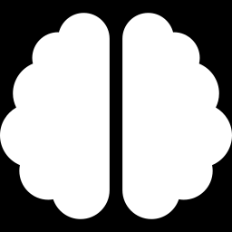
Knowledge Distillation
for Large Language Models
~15-Minute Lesson Plan

Slide 2



01
Why Distillation?
Large language models with hundreds of billions of parameters are expensive to run — they need specialized hardware, consume significant energy, and are too slow for many real-time applications.
Distillation transfers a large model's learned knowledge into a smaller, faster model that approaches the original's quality.
100B+ params
Require GPU clusters
Seconds
Too slow for real-time
Discussion: Where might you need a smaller, faster model? Edge devices, latency-sensitive APIs, cost-constrained deployments.
$$$
Per-query expense

Slide 3
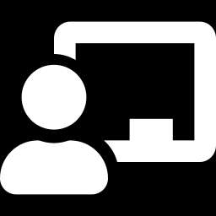
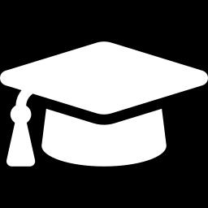

02
The Teacher-Student Framework
Teacher Model
Student Model
Large & Powerful
Compact & Fast
Already fully trained
Hundreds of billions of parameters
Produces rich probability distributions
Not modified during distillation
Smaller architecture
Trained to mimic the teacher
Learns from soft probability labels
Deployable on modest hardware

Slide 4
03
Hard Labels vs. Soft Labels
"The cat sat on the ___"
Hard Label
Soft Label
Standard training — single correct answer
Teacher output — full probability distribution
100%
60%
25%
0%
0%
0%
10%
5%
mat
floor
rug
chair
mat
floor
rug
chair

Slide 5
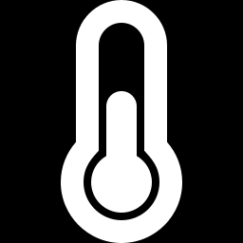

04
Temperature Scaling & the Loss Function
Temperature Scaling
Combined Loss
Higher temperature "softens" the softmax output, spreading probability mass more evenly.
This reveals the teacher's beliefs about less-likely options — nuances that a sharp distribution would hide.
During inference, the student uses normal temperature (T=1).
Distillation Loss
KL divergence between teacher and student soft distributions (at elevated T)
Task Loss
Cross-entropy between student predictions and ground-truth hard labels

Slide 6
05
Distillation Strategies for LLMs
Output-Level
Feature-Level
Student matches the teacher's next-token probability distributions across large corpora. Straightforward but requires running the teacher on the entire training set.
Student matches the teacher's internal representations — hidden states and attention patterns at intermediate layers. Richer signal, especially across different architectures.
Data-Augmented
RLAIF
Teacher generates synthetic training data — reasoning chains, Q&A pairs, paraphrases. The student trains on this augmented dataset. Simpler: only needs text outputs.
Teacher acts as reward model or evaluator, scoring student outputs and providing training signal via reinforcement learning rather than direct imitation.

Slide 7
06
Trade-offs & Practical Considerations
1
Capacity Gap
If the student is too small, it can't absorb the teacher's knowledge. Progressive distillation — chains of decreasing size — can help bridge large gaps.
2
Distribution Mismatch
Distillation data should overlap with the teacher's training data. Out-of-domain distillation may miss the teacher's core strengths.
3
Evaluation
Distilled models excel on familiar tasks but may be brittle on out-of-distribution inputs. Diverse benchmarks are essential.
4
Legal & Policy
Using a proprietary model's outputs to train another model may raise IP concerns. Many providers restrict this in their terms of service.

Slide 8
Key Takeaways
1
Distillation compresses a large teacher model's knowledge into a smaller student model.
2
Soft probability distributions carry richer training signal than hard labels alone.
3
Temperature scaling reveals the teacher's full belief distribution over less-likely options.
4
For LLMs, distillation can happen at the output level, feature level, or via synthetic data.
5
The result: a smaller model that approaches teacher quality at a fraction of the cost.
Further Reading
Hinton, Vinyals & Dean, "Distilling the Knowledge in a Neural Network" (2015) | Sanh et al., "DistilBERT" (2019) | Gu et al., "MiniLLM" (2024)

